Slide 1
General Properties of Ceramic
CERAMIC- FOURTH CLASS
Ceramics generally have specific
properties associated with them such as:
Compressive strength: Ceramics are stronger in compression than in tension, whereas metals have comparable (equivalent) tensile and compressive strengths. This difference is important when we use ceramic components for load-bearing applications. It is necessary to consider the stress distributions in the

Slide 2
ceramic to ensure that they are
compressive. An important example is in the design of concrete bridges—the
CERAMIC- FOURTH CLASS
concrete, a CMC (ceramic matrix
ceramic), must be kept in compression. Ceramics generally have low toughness,
although combining them in composites can dramatically improve this property.
Brittleness: This probably comes from personal experiences such as dropping a glass cup or a plate. The reason that the

Slide 3
majority of ceramics are brittle is the
CERAMIC- FOURTH CLASS
mixed ionic–covalent bonding that holds
the constituent atoms together. At high temperatures (above the glass transition temperature) glass no longer behaves in a brittle manner; it behaves as a viscous liquid. That is why it is easy to form glass into complicated shapes. So, what we can say is that most ceramics are brittle at room temperature but not necessarily at elevated temperatures. The brittle

Slide 4
behaviour of ceramics gives them low
CERAMIC- FOURTH CLASS
fracture toughness.
Ceramic materials are relatively stiff and strong—stiffness and strength are comparable (similar) to those of the metals. In addition, ceramics are typically very hard. On the other hand, they are extremely brittle (lack ductility) and are highly vulnerable to fracture.

Slide 5

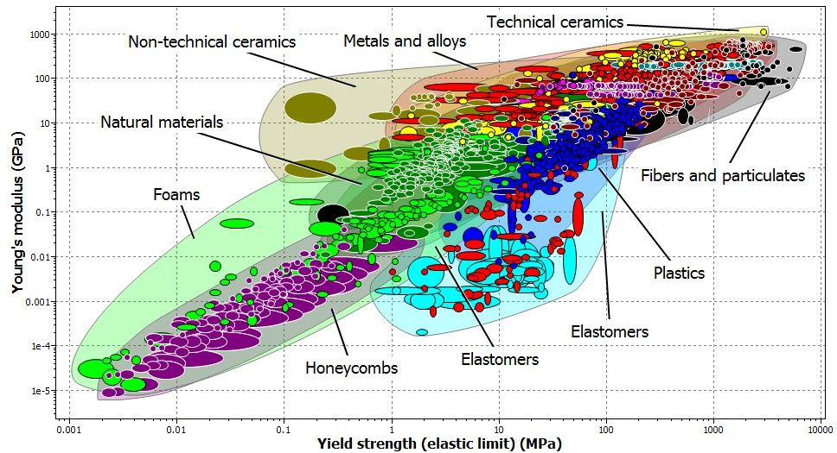

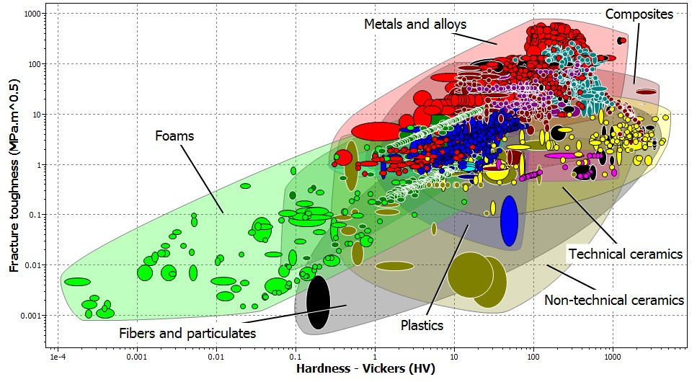
CERAMIC- FOURTH CLASS

Slide 6
Poor electrical and thermal
CERAMIC- FOURTH CLASS
conduction except for Diamond and
the oxide ceramic, ReO3. The valence electrons are tied up in bonds and are not free as they are in metals. In metals, it is the free electrons that determine many of their electrical and thermal properties.

Slide 7

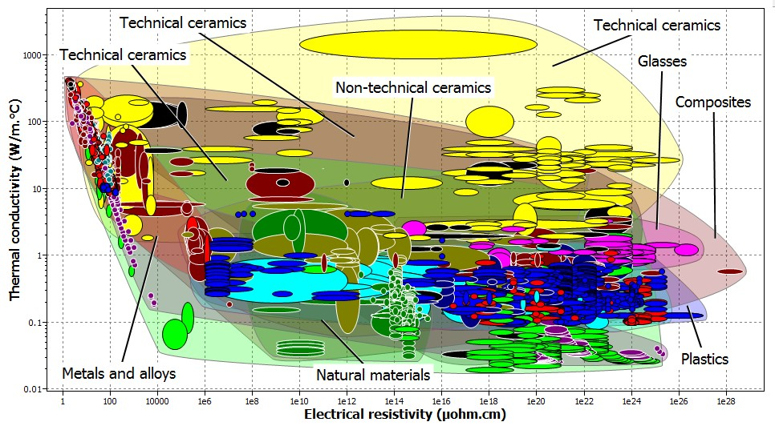
CERAMIC- FOURTH CLASS
Chemical insensitivity: A large
number of ceramics are stable in both harsh chemical and thermal
environments. Pyrex glass is used widely in chemistry laboratories specifically

Slide 8
because it is resistant to many corrosive
CERAMIC- FOURTH CLASS
chemicals, stable at high temperatures (it
does not soften until 1100 K), and is resistant to thermal shock because of its low coefficient of thermal expansion (33
× 10−7 K⁻¹). It is also widely used in bakeware.

Slide 9

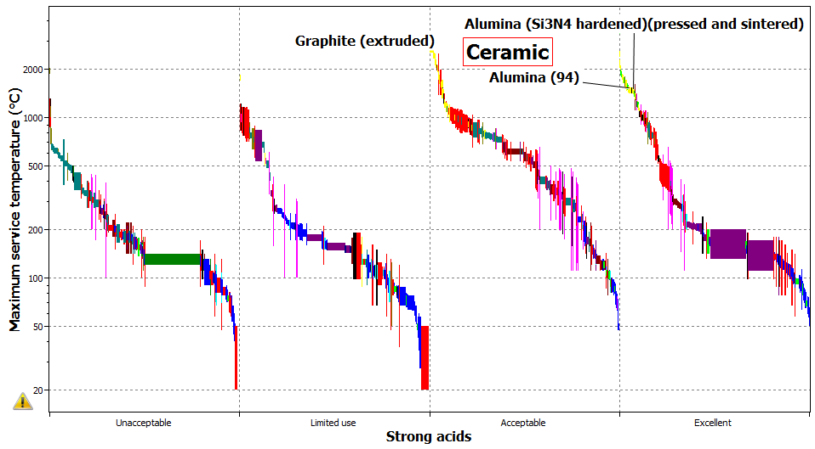
CERAMIC- FOURTH CLASS
So, they are more resistant to high
temperatures and harsh environments than metals and polymers.
Transparency: Many ceramics such as precious stones and optical fibres are

Slide 10
transparent. Metals are transparent to
CERAMIC- FOURTH CLASS
visible light only when they are very thin,
typically less than 0.1 μm. Although it is always possible to find at least one ceramic that shows a typical behaviour, the properties we have mentioned here are in many cases different from those shown by metals and polymers.

Slide 11
Fabrication and Processing of Ceramics
CERAMIC- FOURTH CLASS
One chief concern in the application of
ceramic materials is the method of fabrication.
Many of the metal-forming operations rely on casting and/or techniques that involve some form of plastic deformation. Since ceramic materials have relatively high melting temperatures, casting them is normally impractical. Furthermore, in most

Slide 12
instances the brittleness of these
materials prevents (prohibits)
CERAMIC- FOURTH CLASS
deformation. Some ceramic pieces are
formed from powders (or particulate collections) that must ultimately be dried
and fired. Glass shapes are formed at elevated temperatures from a fluid mass that becomes very viscous upon cooling. A scheme for the several types of ceramic-forming techniques is presented in Figure 1:

Slide 13

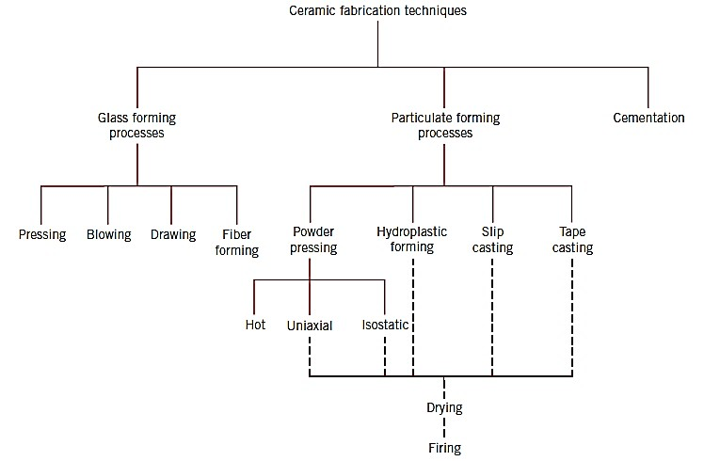
CERAMIC- FOURTH CLASS
Figure 1: A classification forming techniques.
scheme
for ceramic

